Slide 1
Face Tracking Robotic Arm
Presented By: Ansh Sharma (22070127011) Priyanshu Lathi (22070127048) Harmanaya Sharma (22070127023)
Guides: Dr. Javed Sayyed Dr. Ramesh B T

Slide 2
INTRODUCTION
In the dynamic realm of robotics, the pursuit of enhancing human-robot interaction stands as a cornerstone of innovation and creativity.
The "Face Tracking Robotic Arm" project merges Arduino-based robotics, OpenCV for computer vision, and PID control algorithms. It tracks human faces in real-time and controls a 3D printed robotic arm made from PLA filament.
This project seeks to bridge the gap between human expression and machine precision, harnessing advanced control systems to enable seamless tracking of facial movements. The motivation behind this project stems from the growing demand for smart and interactive robotic systems in various fields, including surveillance, human-computer interaction, and assistive technologies.

Slide 3
OBJECTIVES
To create a real-time face tracking system utilizing computer vision algorithms for detecting and tracking faces within a video stream.
• To incorporate a robotic arm governed by PID algorithms, autonomously adapting its position in response to detected face position and coordinates.
• To implement a robust communication protocol between the computer and the Arduino microcontroller to transmit face coordinates efficiently.
• Optimize the PID control parameters to ensure smooth and accurate movement of the robotic arm for precise face tracking.
• Evaluate the performance of the integrated system in terms of tracking accuracy, responsiveness, and overall reliability in various environmental conditions.

Slide 4
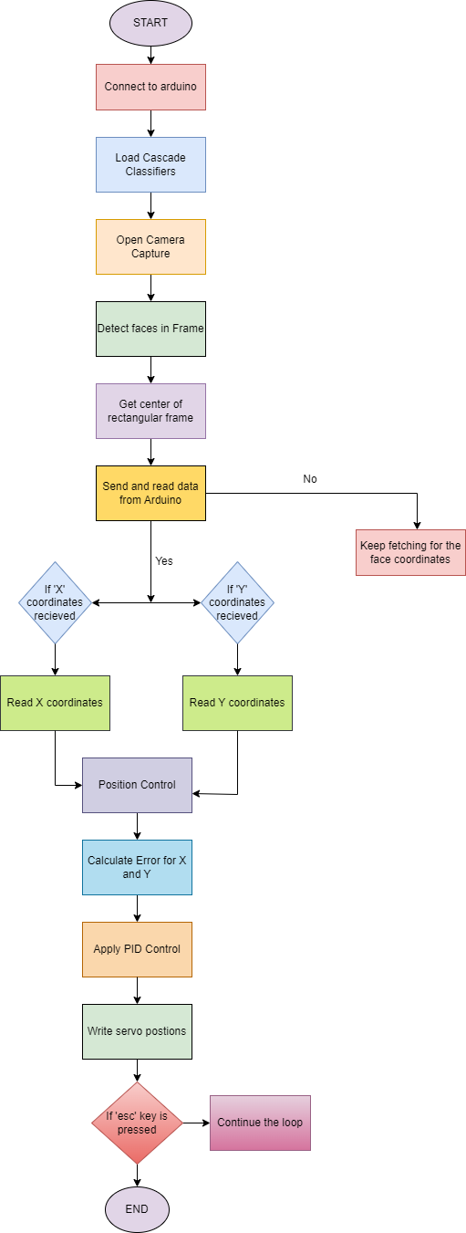
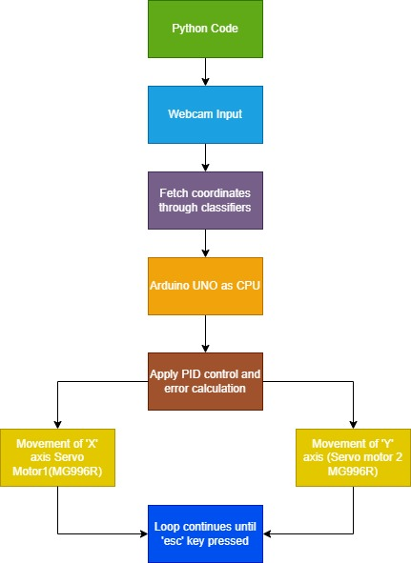
METHODOLOGY
Flowchart
Block Diagram

Slide 5
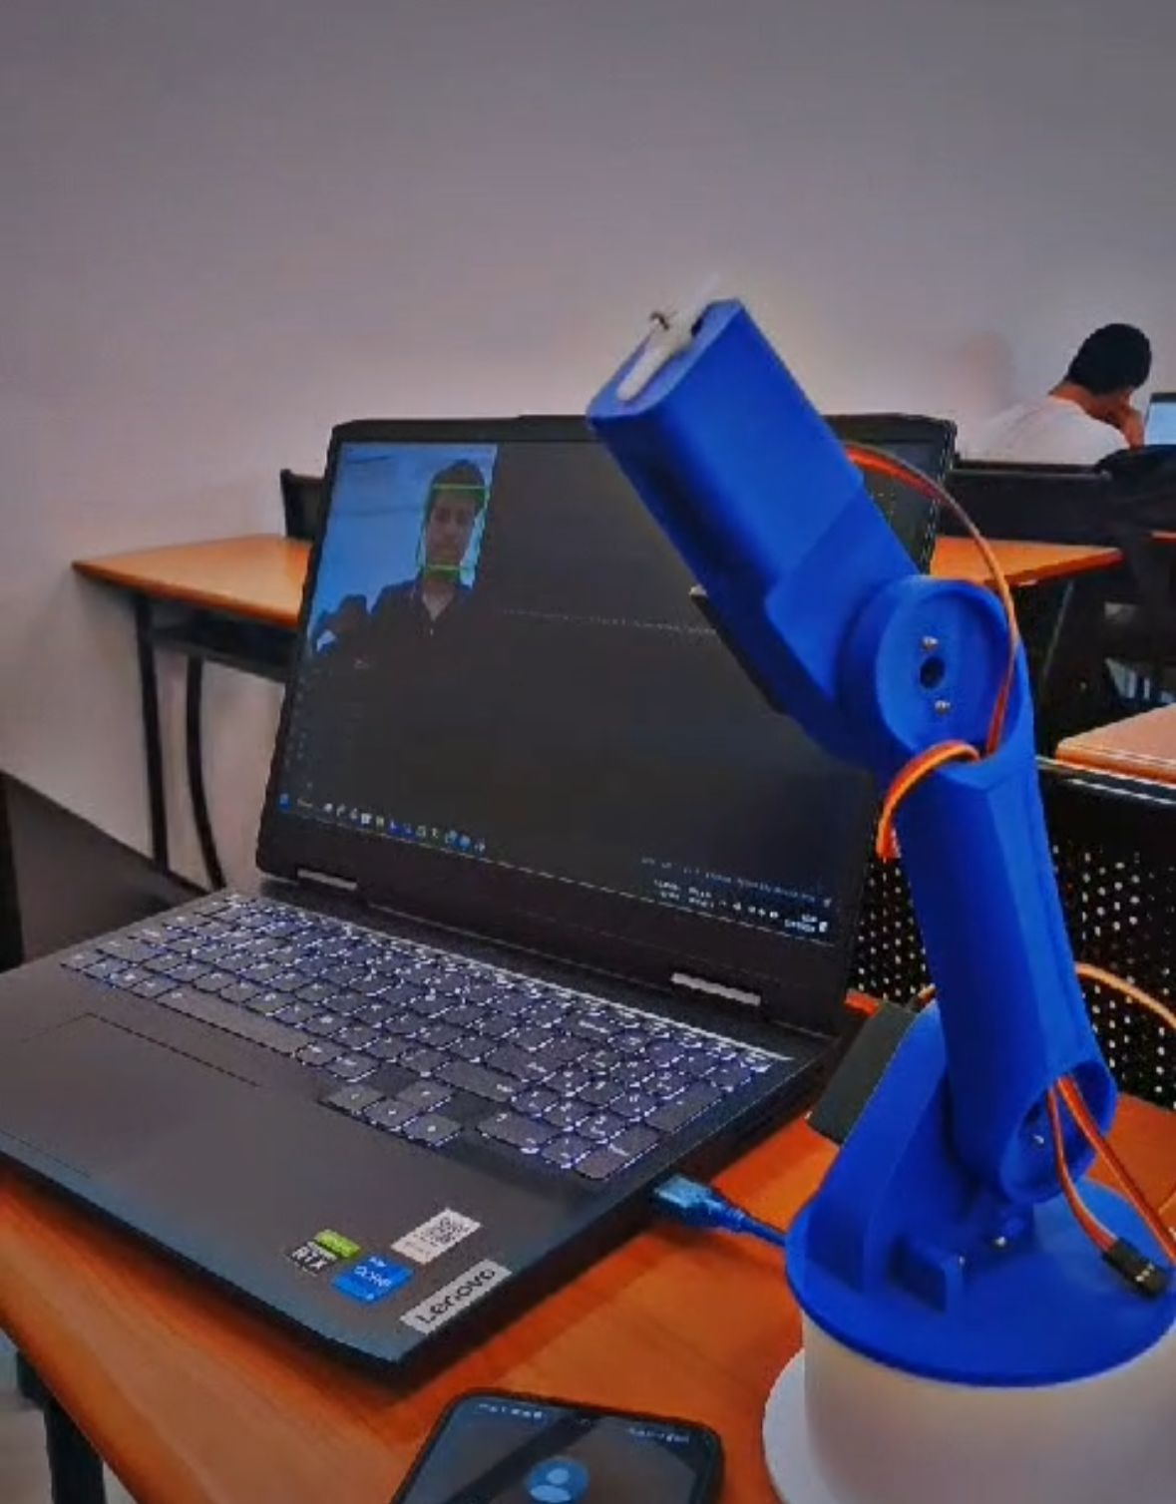
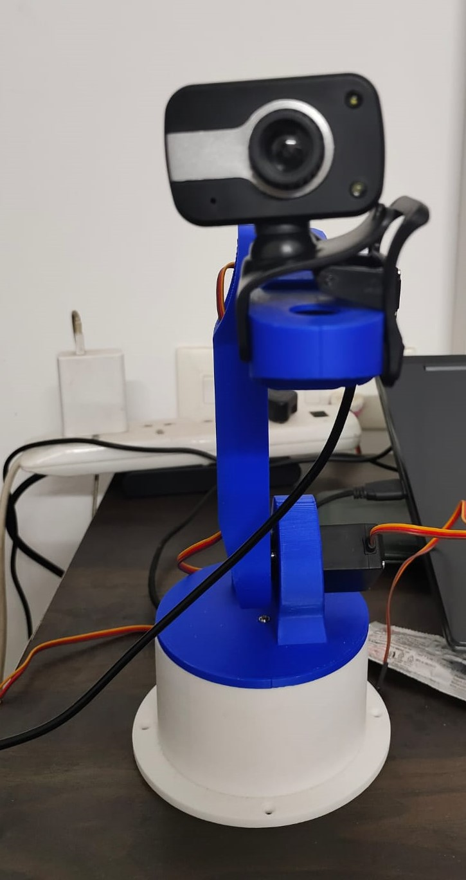
The result of the Facial Tracking Robot Arm project demonstrates its successful, implementation in accurately tracking facial movements.
RESULTS

Slide 6
CONCLUSION
The "Face Tracking Robotic Arm" project represents a successful integration of Arduino-based robotics, computer vision, and control theory to create an intelligent and interactive robotic system capable of tracking human faces in real-time.
Using OpenCV for face detection and a Python-based PID control algorithm, we created a robust tracking system.
Future enhancements could include the integration of additional sensors for environment perception, advanced motion planning algorithms for smoother arm movements, and the incorporation of machine learning techniques for enhanced face recognition capabilities.

